Slide 1

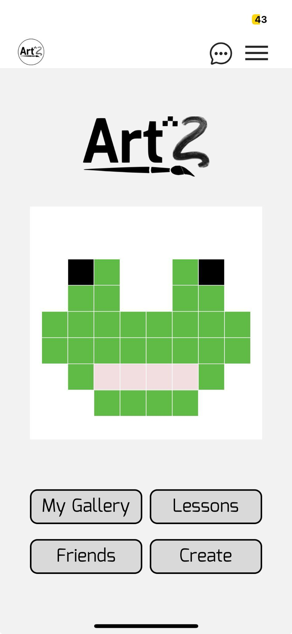
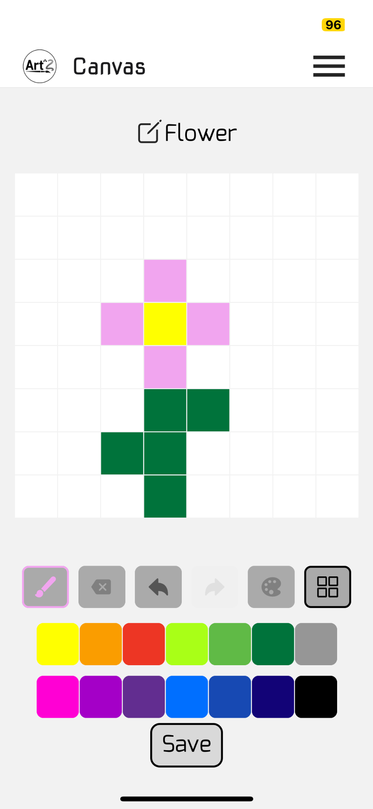
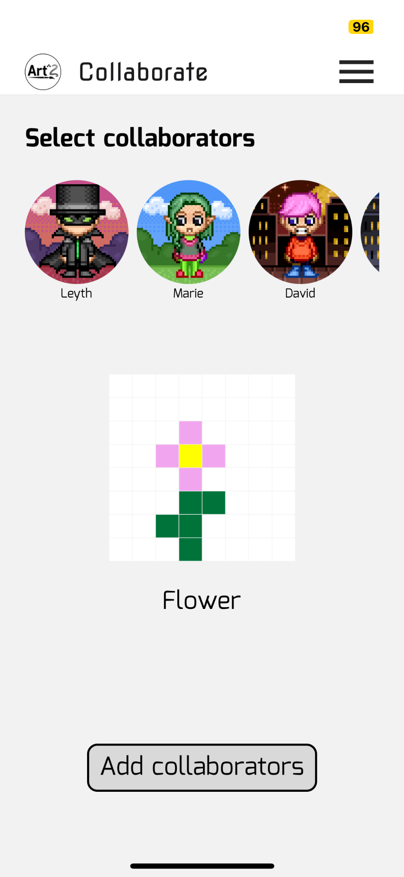
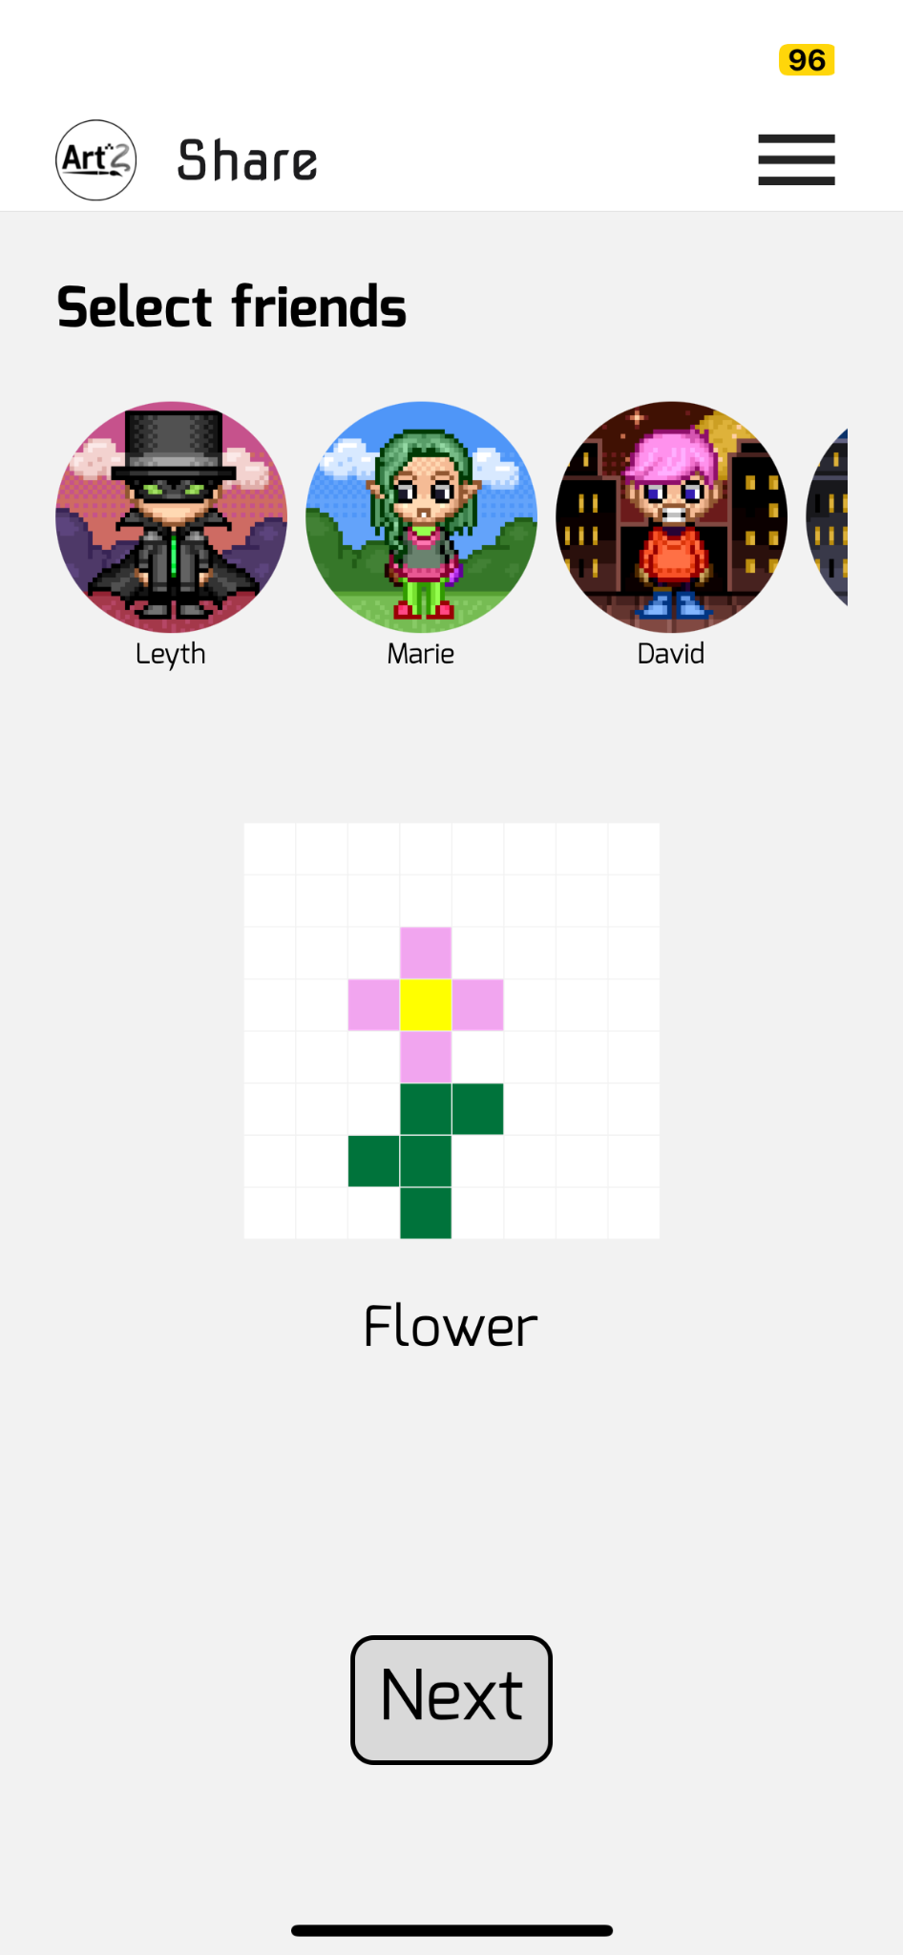
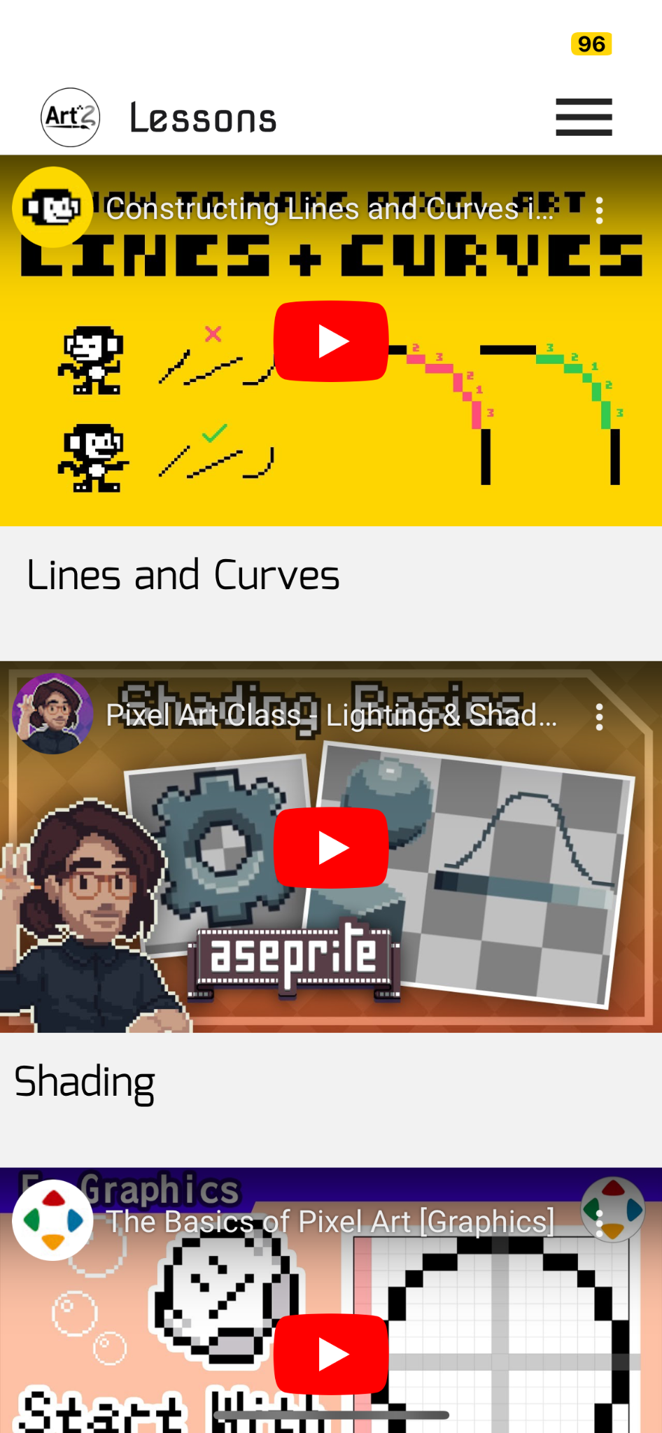

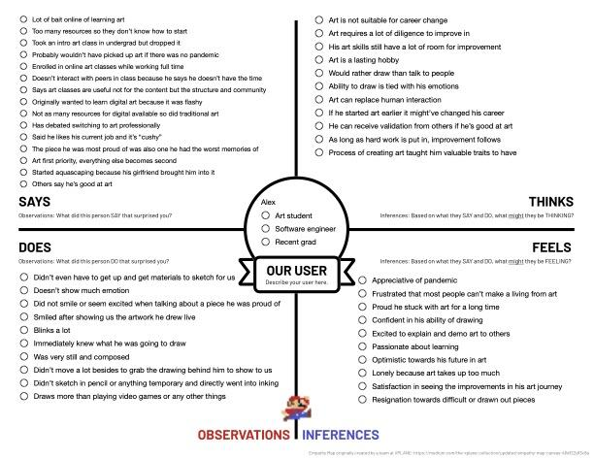
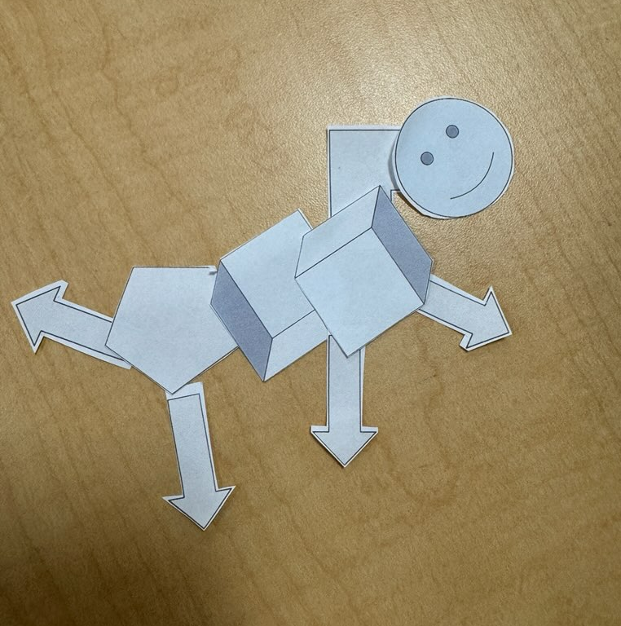
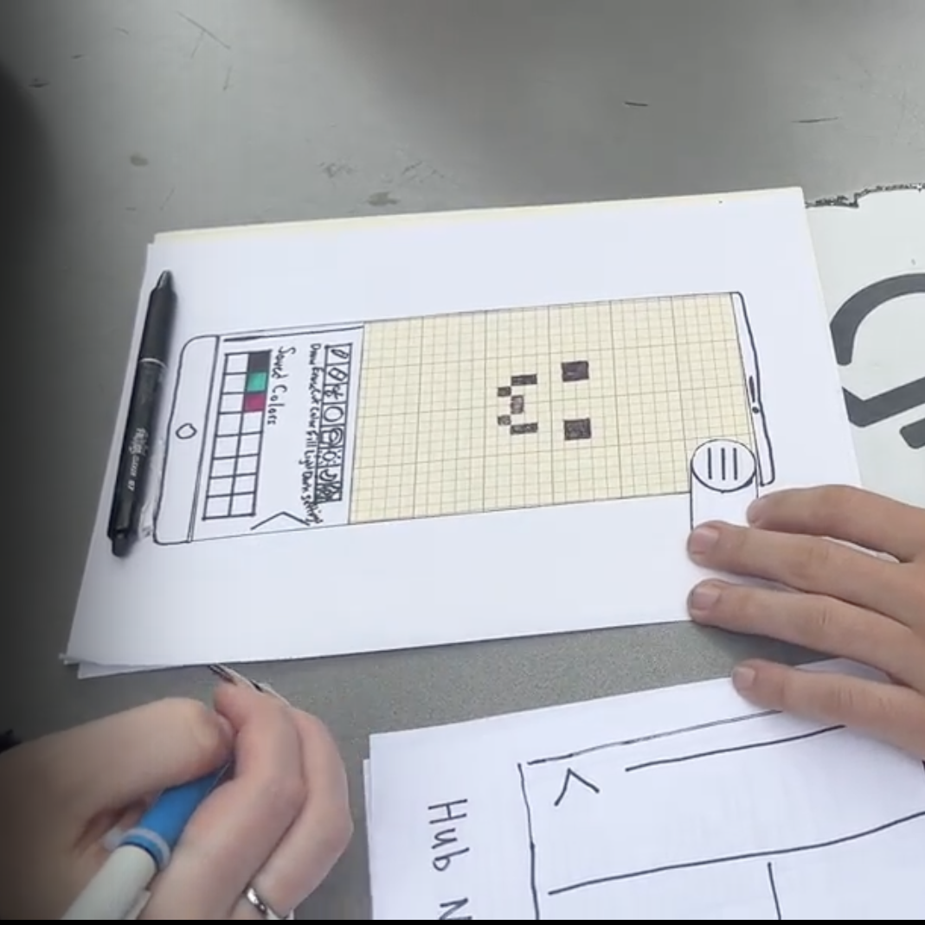
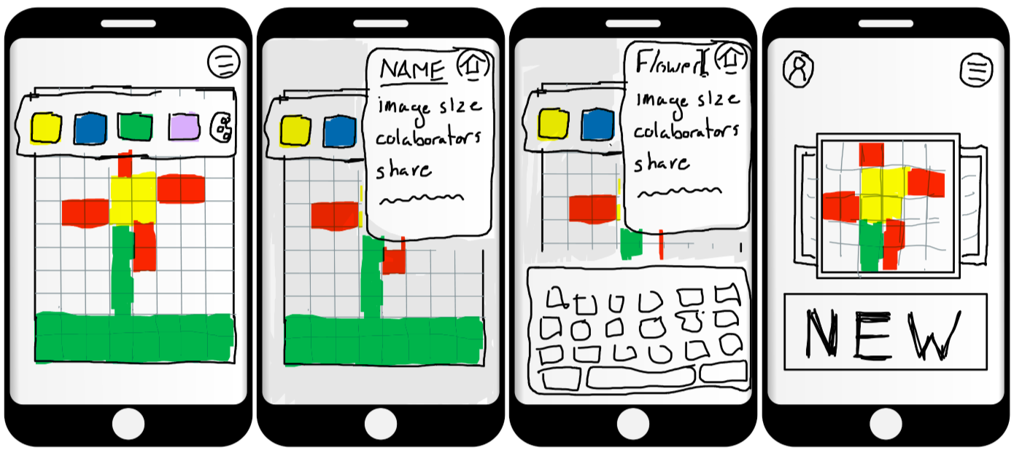
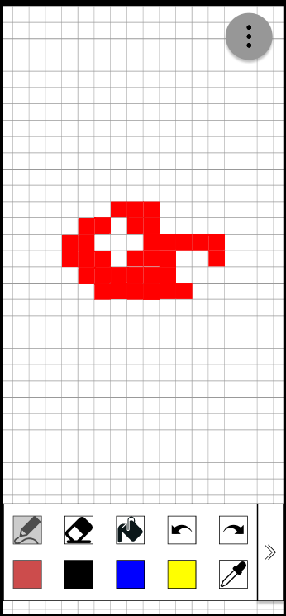
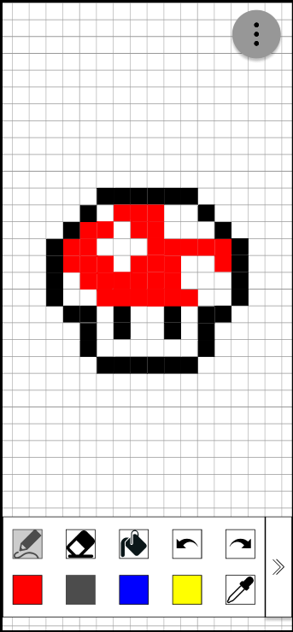


Marie C. David C. Becky M. Leyth T.
Learn art and build your community - one pixel at a time
Home
Create
Collab
Share
Learn
Design Process
1. Needfinding
2. Assumption
3. Testing
4. Sketches
5. low-fi
Problem
Solution
It’s difficult to learn art and creative expression beyond school
Collaborative, creative environment for users to learn pixel art on the go
CS 147 Autumn 2023
Project Website: https://web.stanford.edu/class/cs147/projects/UnlockingLifelongLearning/ArtSquared/
Notes:
Design notes from teaching team - avoid words, use visuals
Put pictures from user testing in circles, and have pixel art clip art?

